Slide 2
Reference
https://dj4e.com/lectures/DJ-02-Model-Single.txt

Slide 3
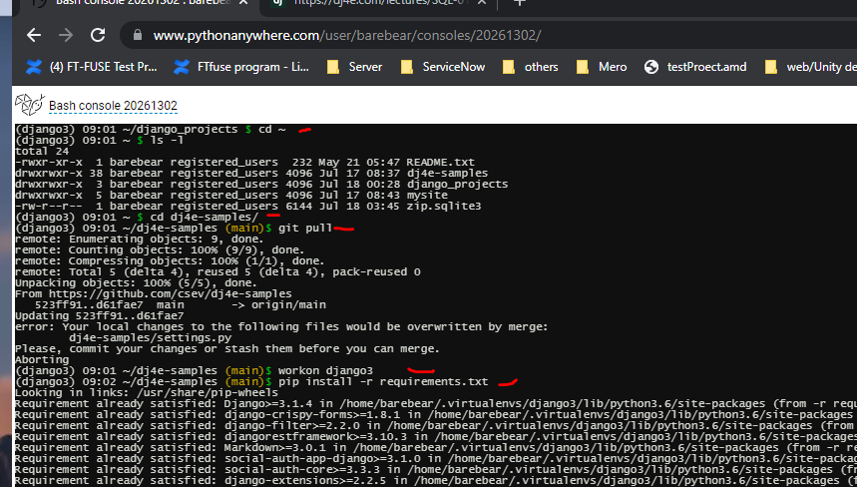
Home directory and git pull latest update
cd ~
cd dj4e-samples
git pull
workon django3
pip3 install –r requirements.txt (just make sure download all the libraries needed )

Slide 4
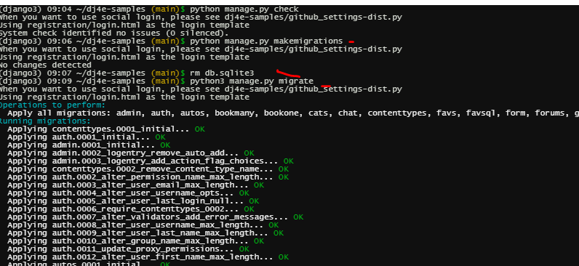
Makemigration & migrate
python3 manage.py makemigrations
python3 manage.py migrate
Notes:
Makemigration: Django read all the models.py files (in different applications) and creating migrations
Migrate: read all the migrations files and create the database and a bunch of tables in that database

Slide 5
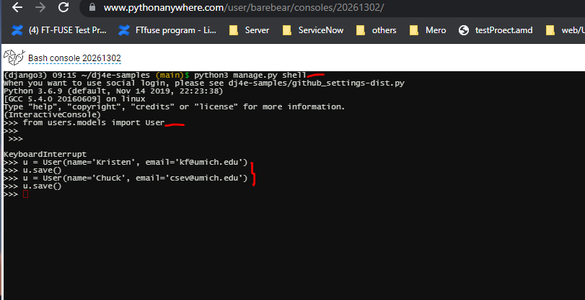
Start Django shell and interact with database
python3 manage.py shell
from users.models import User
U = User(name=‘Kristen’, name=xx@gamil.com)
U.save()
Notes:
python3 manage.py shell: Starting Django and loading all the Django libries and reading all the Django configrationfiles
from users.models import User : Refer to User table
U = User(name=‘Kristen’, name=xx@gamil.com) : create a new user model object. At this moment it was not saved in the database
U.save(): save the update in the database

Slide 6
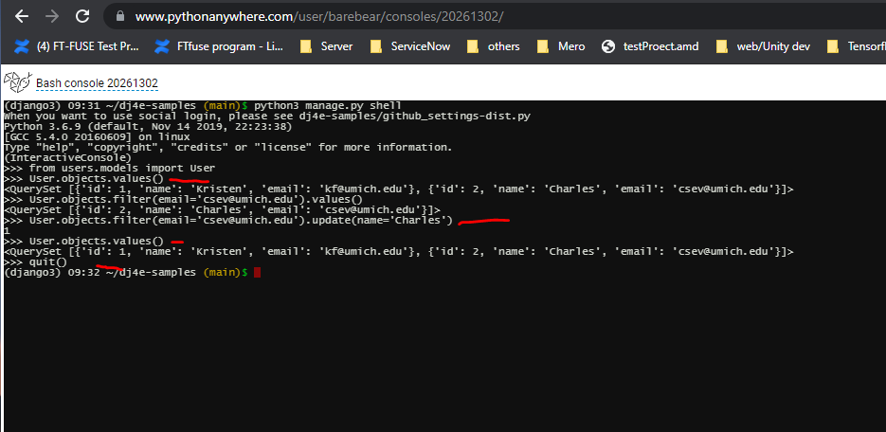
How to retrieve database info
User.objects.values()
User.objects.filter(email=‘csev@umich.edu’).values()
User.objects.filter(email=‘csev@umich.edu’).update(name=‘Charles’)
quit()

